Slide 1
AMMnet meeting, Dakar
2025
Developing data visualization dashboards in R
Demba Kande
Sarja Jarjusey
Hayley Thompson

Slide 2
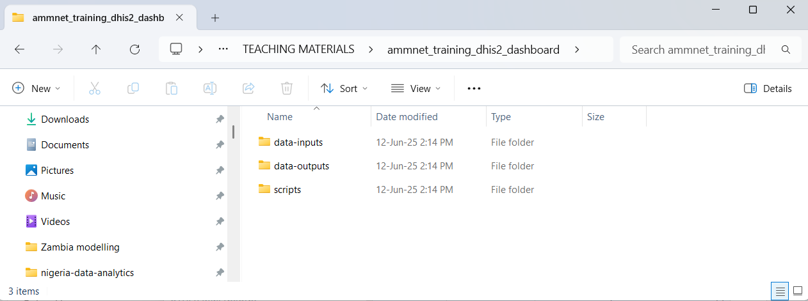




Preparation for the session while we wait to start
ENSURE YOU HAVE INTERNET ACCESS
ENSURE YOU HAVE R AND RSTUDIO DOWNLOADED
MAKE A FOLDER IN A SENSIBLE PLACE ON YOUR COMPUTER CALLED SOMETHING LIKE ‘ammnet_training_dhis2_dashboard’
Within this folder make a three subfolders
If you know how to create a project in R, do so in this same folder (ask a facilitator or neighbor for help if not)
This is where we store ‘raw’ data i.e. downloads from DHIS2
This is where we store data that we have processed ourselves
This is where we store all R scripts

Slide 3
Structure of the workshop
Session 1: How to manually pull data from DHIS2 and clean it ready for use in a dashboard
Session 2: Developing a simple Rshiny dashboard to visualize routine malaria data

Slide 4
Introduction to DHIS2
DHIS2 in an open-source, web-based health management information system (HMIS) platform developed by the University of Oslo. It supports data collection, analysis, visualization, and reporting.
It has been adopted by ministries of health in over 70 countries, especially across Africa, Asia, and Latin America. Commonly used at national and sub-national levels for routine health data reporting.
Key features of DHIS2 are:
Captures data from health facilities and programs (e.g., malaria, HIV, maternal health)
Enables real-time dashboards, maps, and charts for decision-making
Supports integrated, decentralized data entry across the health system
Facilitates monitoring, evaluation, and planning through tailored analytics

Slide 5
Plan for session 1
Learn how to access DHIS2
Explore some existing dashboards to see graphical functionality
Learn how to make a data query to access the data elements, time period and geographical units of interest
Download data as a csv
Read data into R
Clean data, including name cleaning, visual inspection of outliers/missing data, cross-referencing different variables
The outcome of this session is a cleaned malaria dataset that we’ll use for part 2 (building a shiny dashboard)

Slide 6
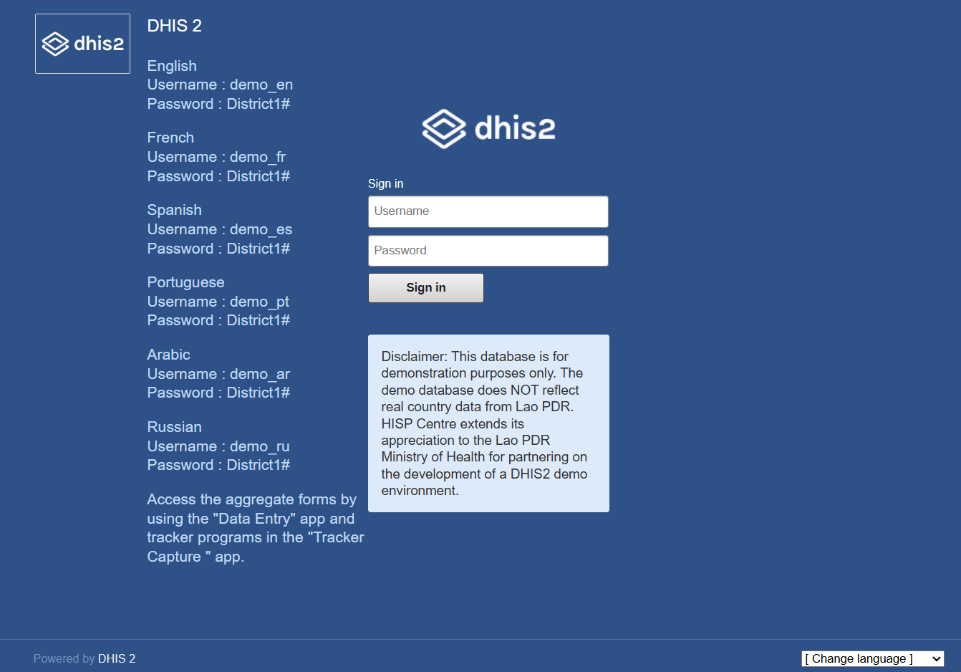
Navigating around DHIS2
DHIS2 has a demonstration database available based on Lao PDR but containing made-up data
This is what we’ll be using in today's workshop
https://demos.dhis2.org/hmis/

Slide 7
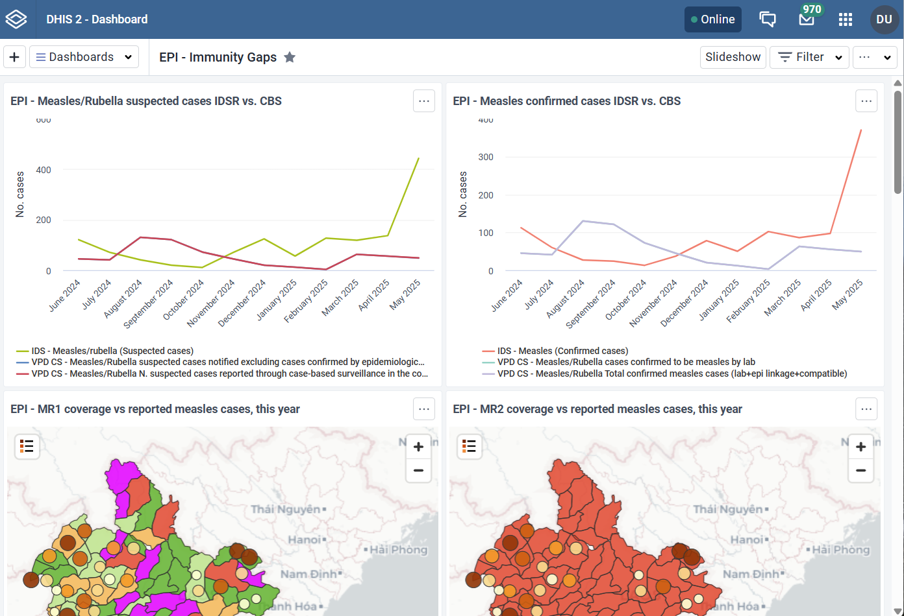
Existing dashboards
When you first open this instance of DHIS2 you will see some pre-made dashboards on vaccine-preventable diseases and vaccine coverage rates
You can explore other pre-made dashboards to see what is possible within DHIS2

Slide 8
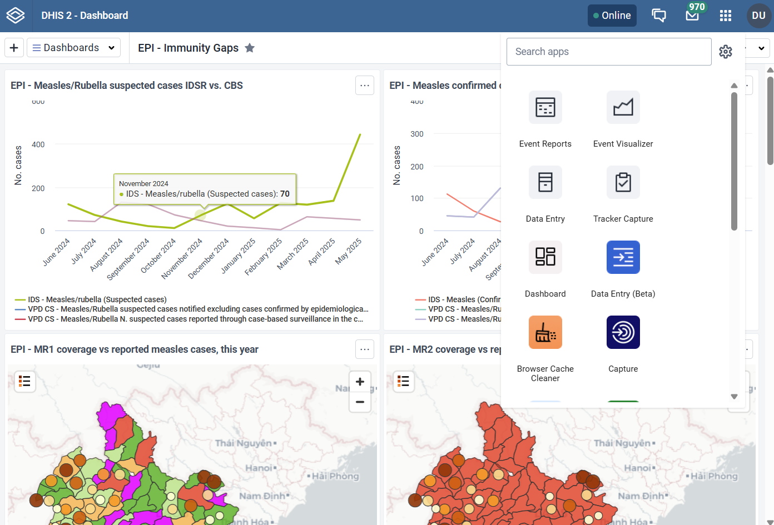
Accessing raw data
DHIS2 does have lots of visualization capabilities, however, we often want to extract data from DHIS2 to conduct our own bespoke analyses – i.e. a risk stratification or a statistical model looking at intervention impact
To access the raw data, you need to click this 3x3 grid

Slide 9
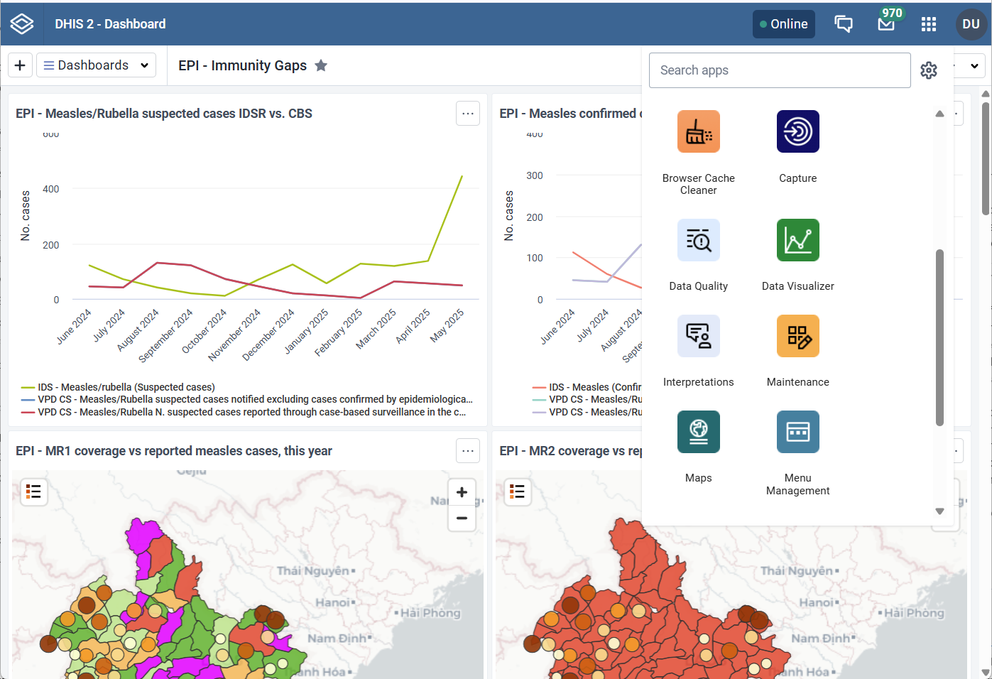
Finding data visualizer
DHIS2 does have lots of visualization capabilities, however, we often want to extract data from DHIS2 to conduct our own bespoke analyses – i.e. a risk stratification or a statistical model looking at intervention impact
Scroll down this menu and select ‘data visualizer’

Slide 10
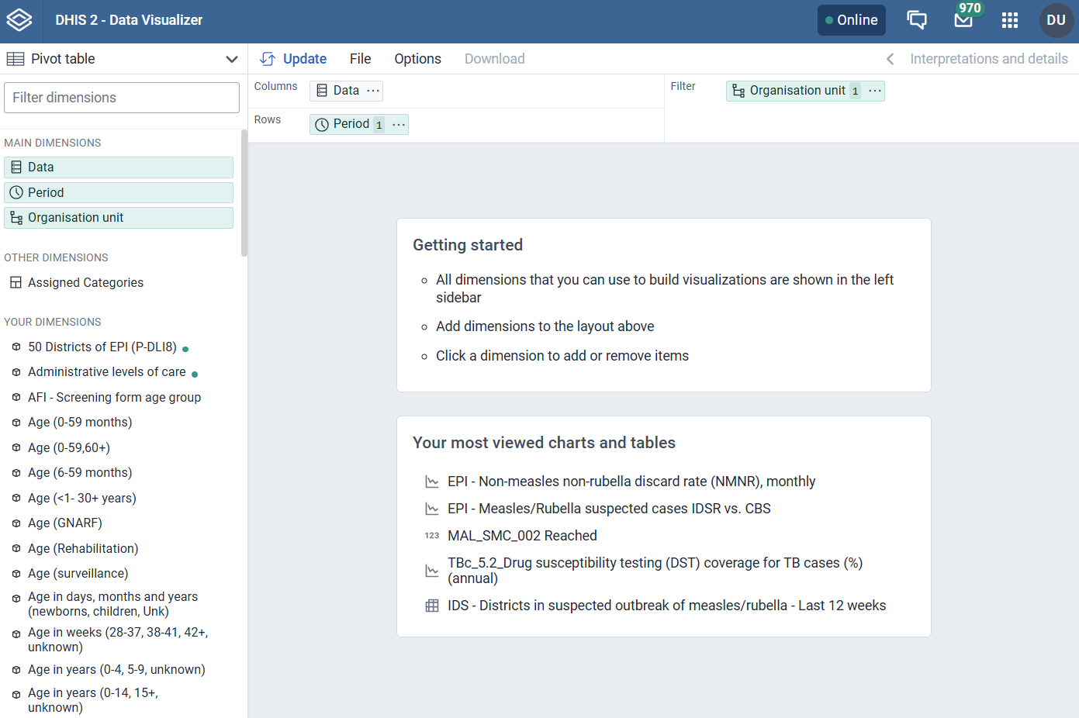
Navigating data visualizer
You should now see this screen – there are several important components of this page
For extracting raw data, we want to use the pivot table, but there are options here to present data in different graph formats
This is where you select the data, period and organisation unit (i.e. Health facility, ward, district etc.
We’ll now look at these one by one on the next slides

Slide 11
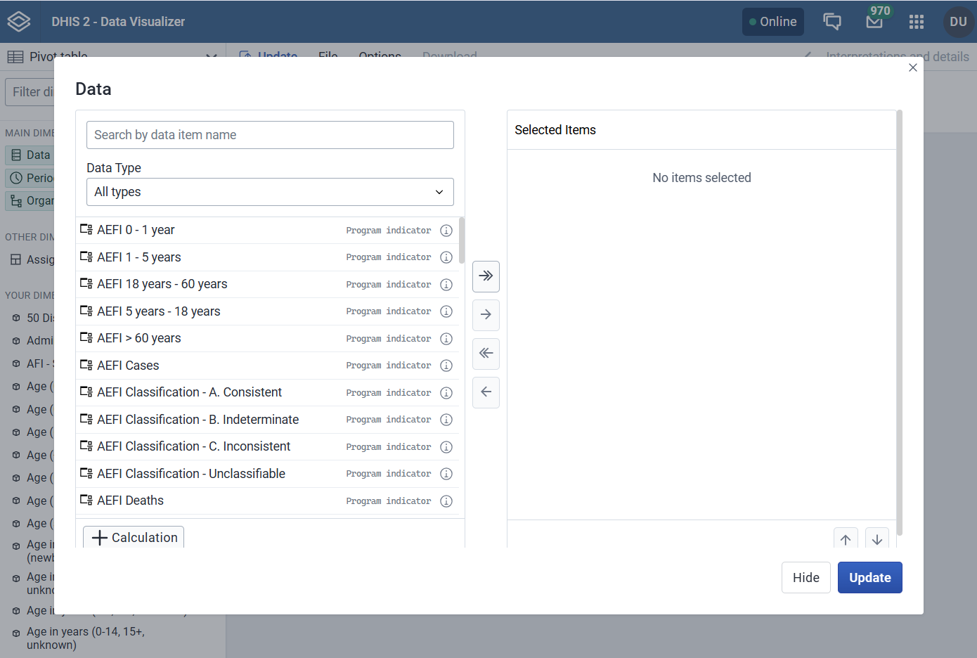
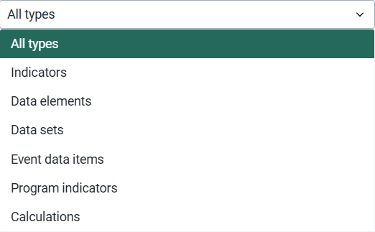
Data dimension
Click on the ‘data’ option to see this menu
Here you can see there are a range of ‘data types’
Today we’ll focus on
Data elements – these are the building blocks of data in DHIS2 – its typically a ‘count’, i.e. malaria cases, or RDTs conducted
Indicators – these are calculated based on a combination of the data elements i.e. Number of tests conducted = # RDT + # microscopy, incidence = cases/population

Slide 12
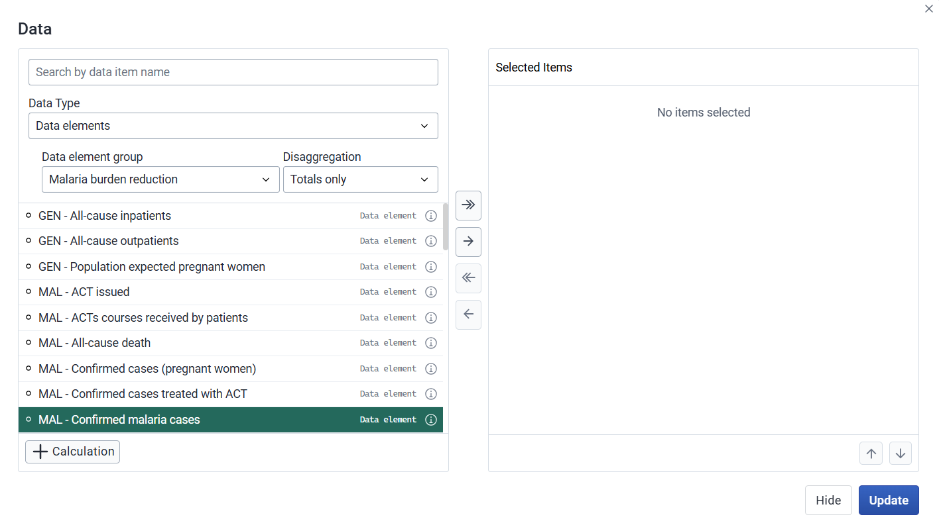
Avoid the malaria indicators with a ‘CH’ prefix – these relate to cases detected via community case management – today we’ll focus on malaria cases reported at health facilities
Finding malaria data (1)
Firstly, select data elements
Next select malaria burden reduction in the data element group box
Here we see a wide range of malaria burden variables
For todays example, select, we’ll look at confirmed malaria cases and malaria tests (RDTs and microscopy) conducted
To select a variable, highlight it as shown here, then press the top ‘across’ arrow to move it into the selected items section

Slide 13
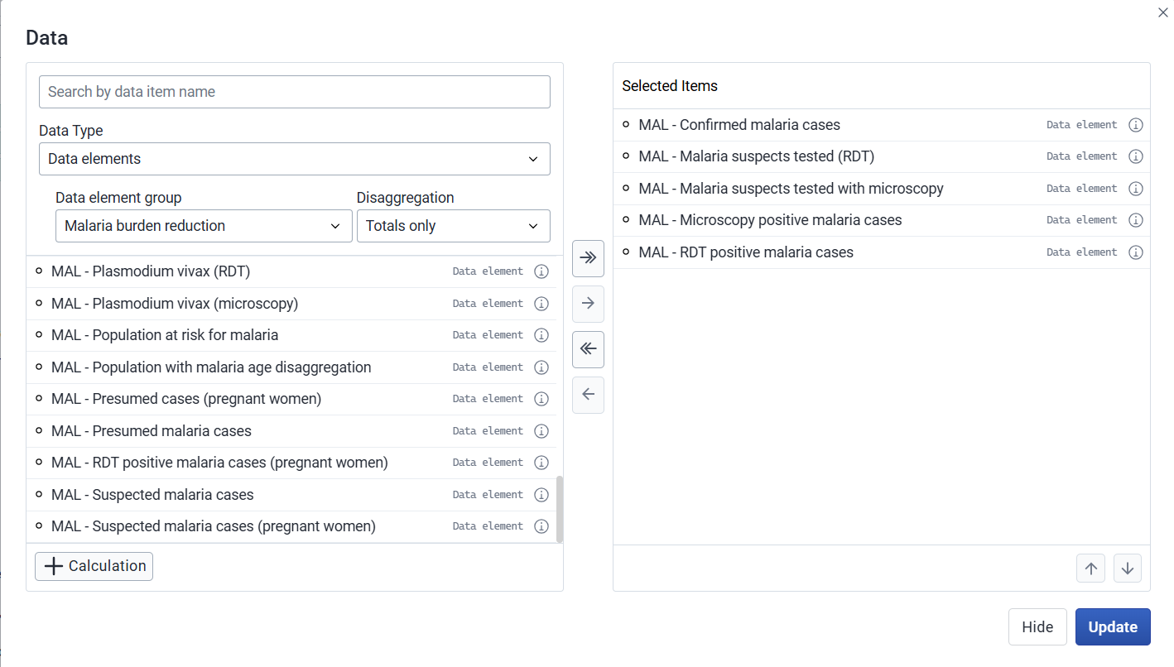
Finding malaria data (2)
Select these 5 malaria data elements

Slide 14
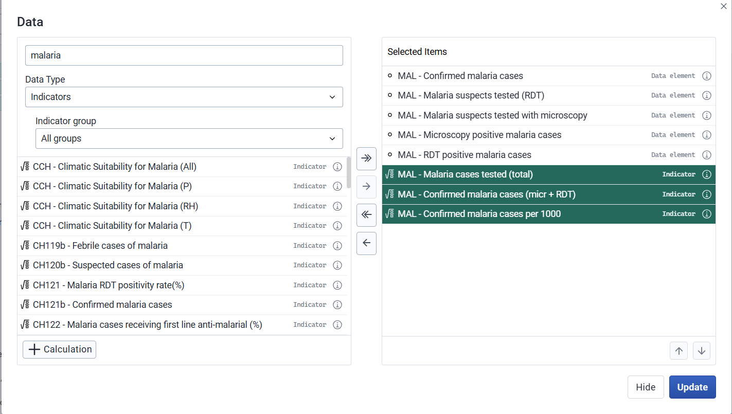
Finding malaria data (3)
We’ll also use some malaria indicators
Another way to find your indicators is simply to type a keywork in the top box
Let’s also select these 3 indicators

Slide 15
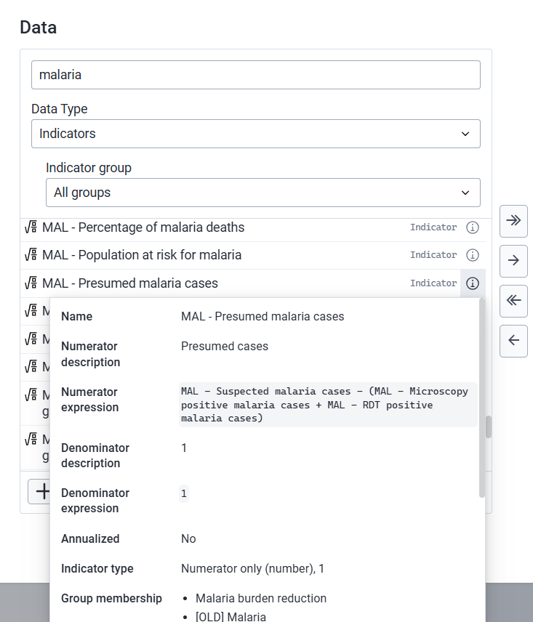
A note on finding the ‘right’ variables
There are typically a lot of variables that relate to malaria burden, and not all countries regularly report all variables – we normally start by asking a local expert which elements/indicators to use
Failing that, we can manually interrogate the data to see which are reported
Feel free to select a much wider range of malaria variable to explore whether they’re all useful, and how they relate to each other
There are also sometimes duplicate variables, for example, this demo DHIS2 has 2 identical indicators for total malaria cases
You can click the circled ‘i’
Here to get more details on each variables

Slide 16
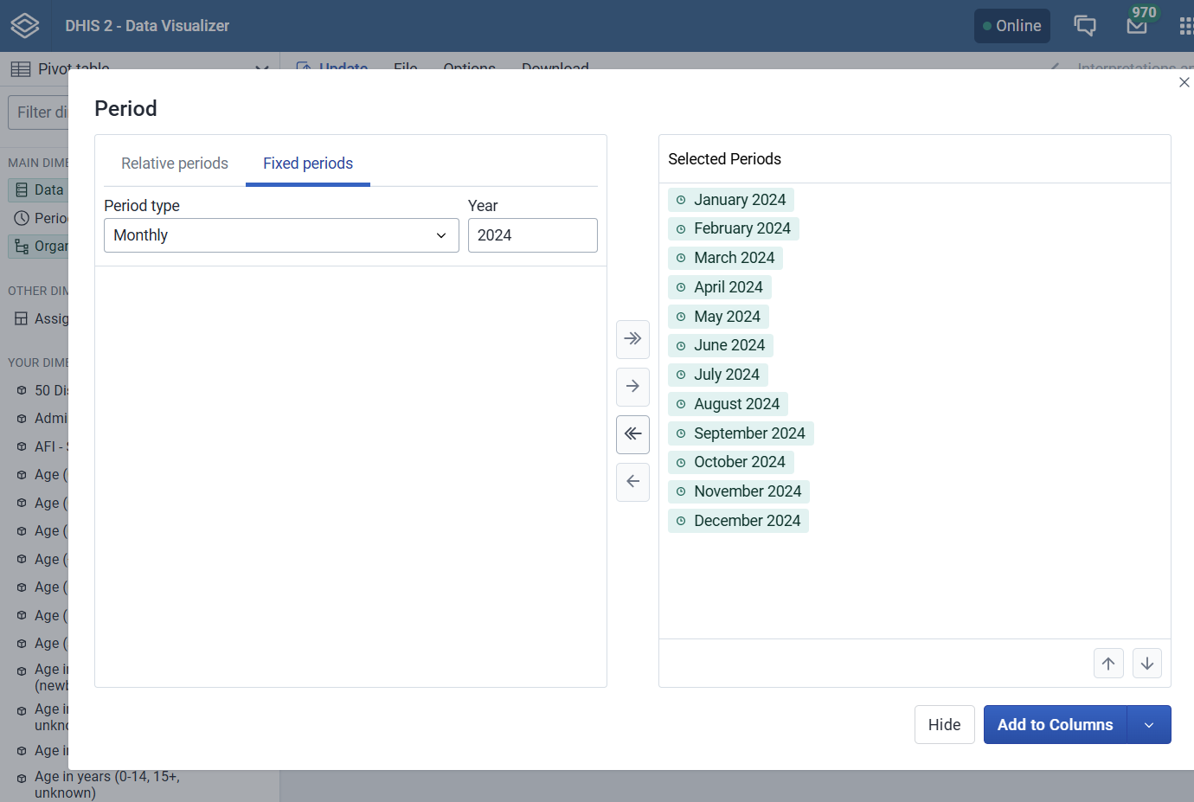
Selecting time periods
Sometimes there is a period auto selected at the top – make sure to remove it by clicking the single right arrow
You can either select a period relative to today (i.e. last 3 months), or you can select fixed periods
In this example, we’re going to look at monthly data from 2024 only
Click the double arrow to bring all months over
First select ‘fixed periods’ and then select ‘monthly’ and ‘2024’

Slide 17
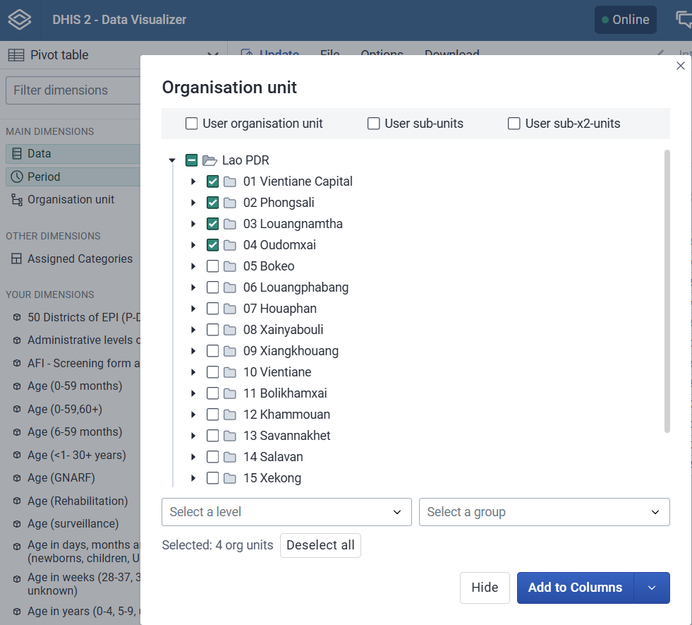
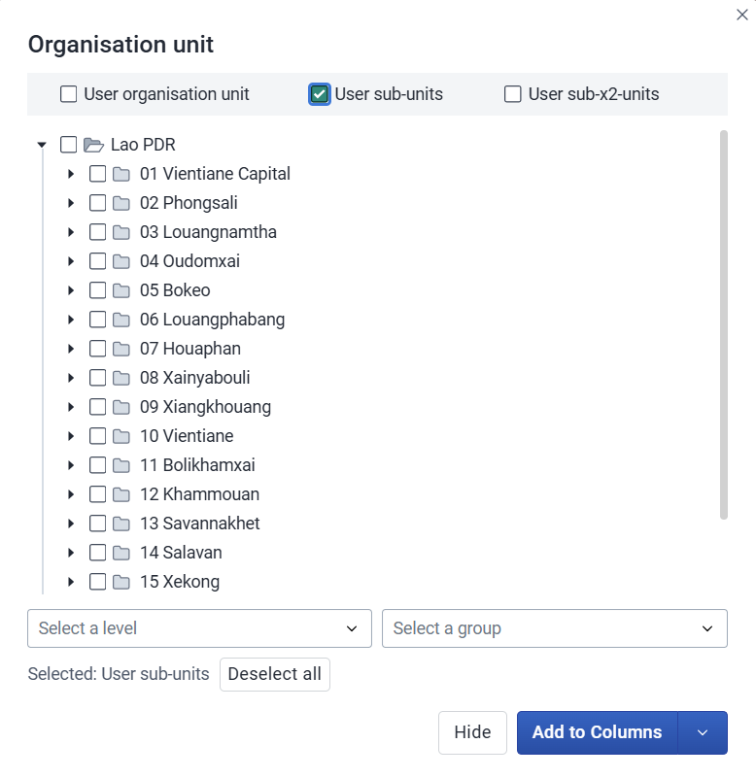
Selecting organization unit
At the moment we’re looking at national totals, but we can also look at the data at smaller spatial units – down to the health facility level
Select organization unit
We can either select all the provinces manually by selecting the boxes – this method is best when we just want to look at a subset of provinces, districts etc.
A quicker option is to just select user sub-units

Slide 18
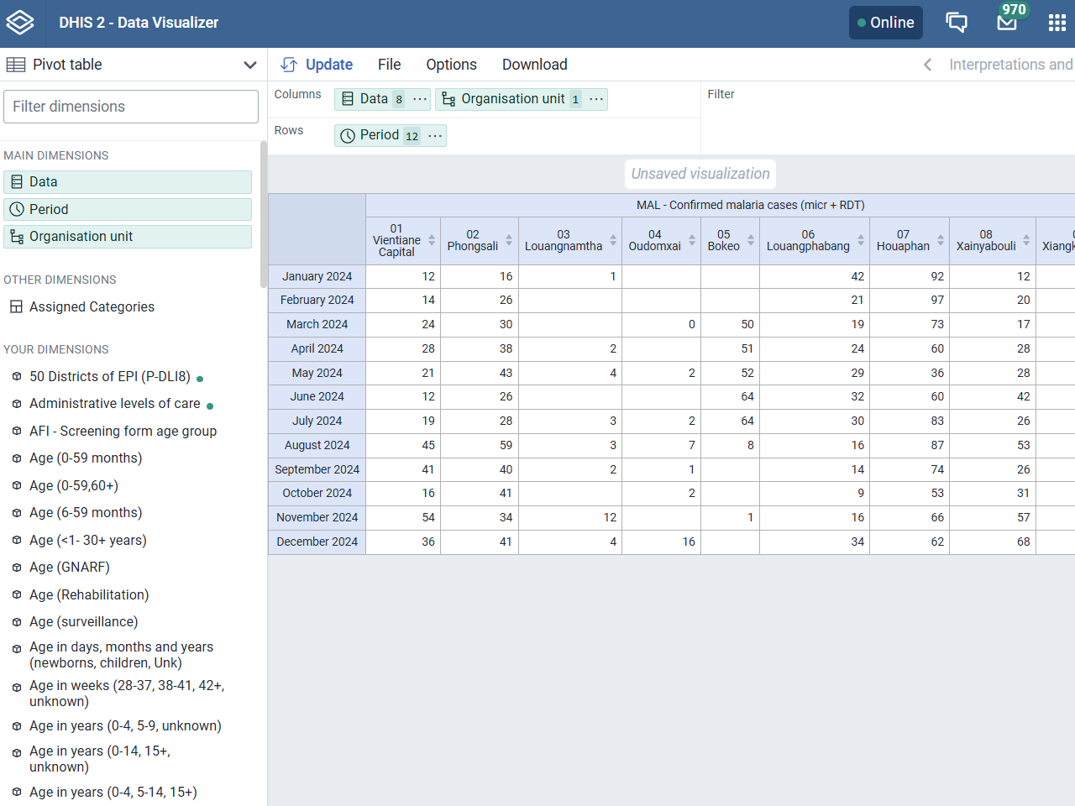
Reorienting and downloading data (1)
The data are returned in a wide format, with 18 columns (one per province) for each indicator
For future data manipulation in R, it’s preferable to have the data in a long format
This is a data format where each row represents a single observation, and each column represents a variable or feature
To make data long format we can drag these green boxes all to the rows’ area (see next slide)
Useful resources for learning about long vs. wide data
https://tavareshugo.github.io/r-intro-tidyverse-gapminder/09-reshaping/index.html

Slide 19
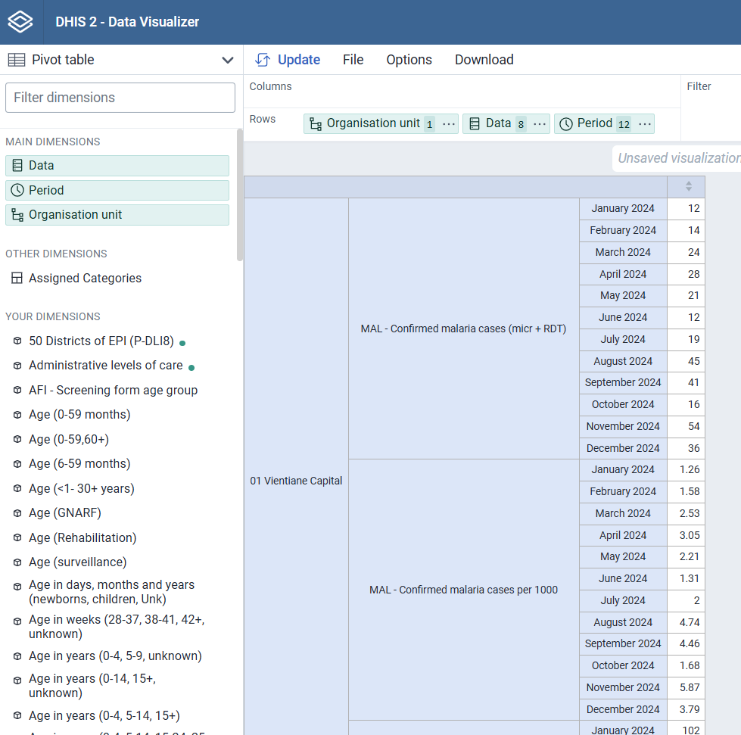
Reorienting and downloading data (2)
You can change to order of these to see what is most logical for your data
You’ll need to update the table each time you modify it

Slide 20
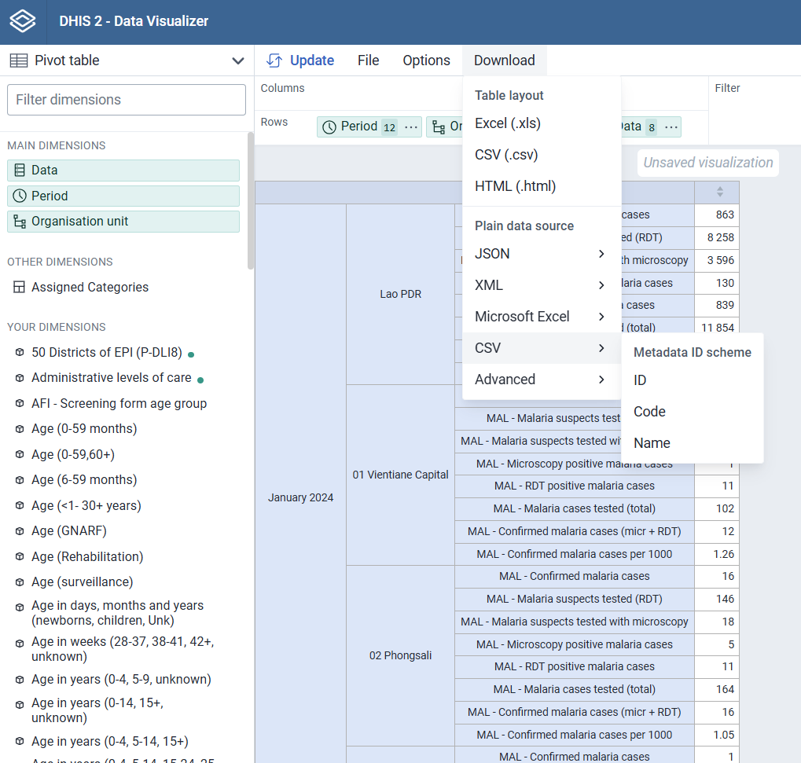
Reorienting and downloading data (3)
We can now download our data as a csv
The easiest data format to work with is plain data source -> CSV -> Name

Slide 21
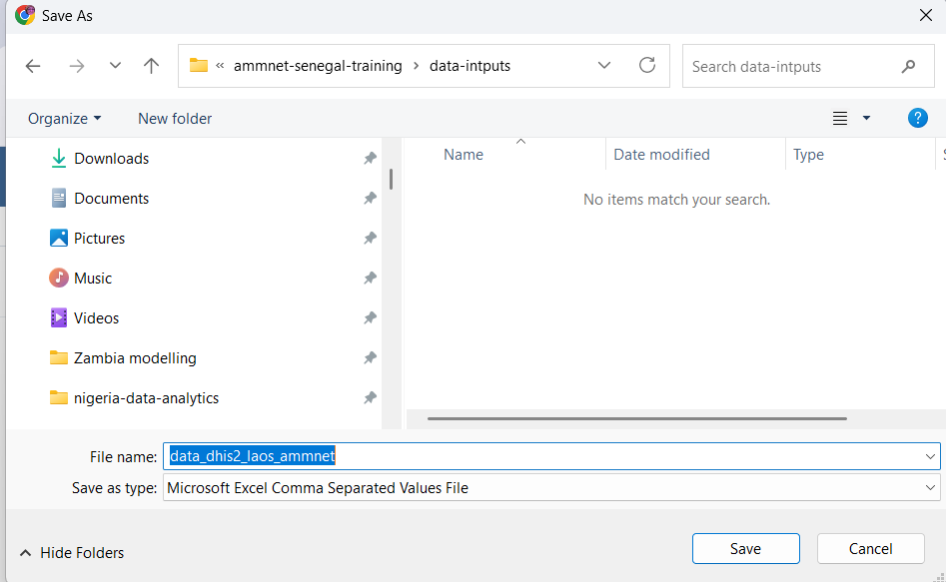
Reorienting and downloading data (4)
Save your data in your data-inputs folder that you created at the start of the session
Rename your file to something informative – I’ve chosen data_dhis2_laos_ammnet

Slide 22
Reading the data in R and cleaning
For this section we just need 2 packages tidyverse and janitor, if you don’t already have them, you can install with the commands
install.packages("tidyverse")
install.packages("janitor")
Step 1: read in the data, clean the names and look at the data
library(tidyverse)
library(janitor)
laos_dat <- read_csv("data-inputs/data_dhis2_laos_ammnet.csv") %>%
clean_names()
head(laos_dat)

Slide 23
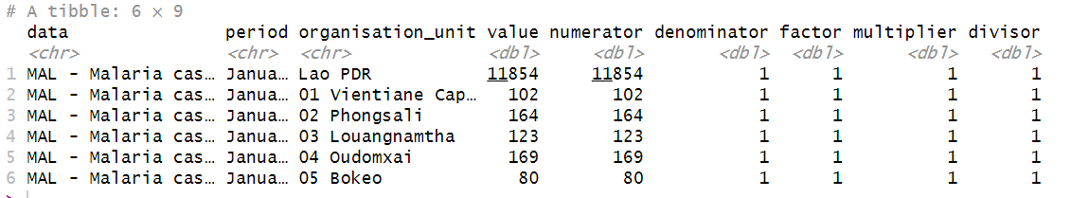
The download returned the national level data, which we don’t want – let’s filter this out
These columns don’t look useful, so lets remove them from our output
Cleaning (1)
These data names look long and cumbersome – let’s shorten them once we decided which ones to use
The date is in character format, but we need it in date format for R to know how it should be ordered
laos_dat_clean <- laos_dat %>%
filter(organisation_unit != "Lao PDR") %>% # filter out national level data
dplyr::select(-c(numerator, denominator, factor, multiplier, divisor)) %>% # remove unused columns
mutate(data = str_replace_all(data, "MAL - ", ""), # remove starting MAL key
data = str_to_lower(data), # lower case
data = str_replace_all(data, " ", "_"), # spaces to underscores
data = str_remove_all(data, "[()]"), # remove parenthesis
data = str_remove_all(data, "[+]")) %>% # remove plus sign in one variable name mutate(month = ymd(parse_date_time(period, orders = "B Y"))) # make month a date variable

Slide 24
Cleaning (2)
It’s a good idea to look at the unique values in each text column to see if they all make sense
We downloaded data that had similar names because we wanted to check for consistency – lets check these now – I’d expect
“MAL - Malaria cases tested (total)” = “MAL - Malaria suspects tested (RDT)” + “MAL - Malaria suspects tested with microscopy”
And
"MAL - Confirmed malaria cases (micr + RDT)" = “MAL - Microscopy positive malaria cases” + "MAL - RDT positive malaria cases" =
unique(laos_dat$data)
[1] "MAL - Malaria cases tested (total)" "MAL - Confirmed malaria cases (micr + RDT)"
[3] "MAL - Confirmed malaria cases per 1000" "MAL - Confirmed malaria cases"
[5] "MAL - Microscopy positive malaria cases" "MAL - Malaria suspects tested (RDT)"
[7] "MAL - Malaria suspects tested with microscopy" "MAL - RDT positive malaria cases"

Slide 25
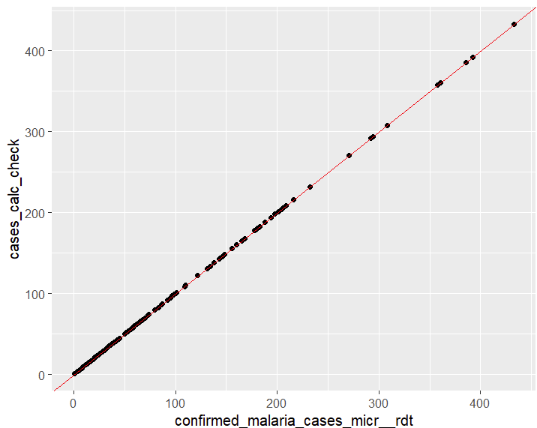
Cleaning (3)
laos_dat_wide <- laos_dat_clean %>%
pivot_wider(names_from = data) %>%
mutate(test_calc_check = rowSums(across(c(malaria_suspects_tested_rdt, malaria_suspects_tested_with_microscopy)), na.rm = TRUE), cases_calc_check = rowSums(across(c(rdt_positive_malaria_cases, microscopy_positive_malaria_cases))))
ggplot(laos_dat_wide) +
geom_point(aes(x = malaria_cases_tested_total,
y = test_calc_check)) +
geom_abline(intercept = 0, slope = 1, color = "red")
Here we see that these 2 variables are consistent, so we can continue just looking at one

Slide 26
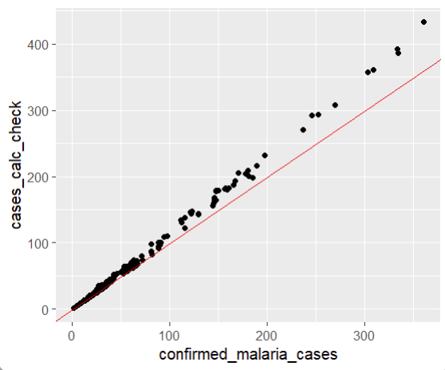
Cleaning (4)
However the same is not true when we compare cases_calc_check with confirmed_malaria cases (we’d expect the points to fall on the red (x=y) line
Q: Can you write the code to generate this plot?
This means we, as the data analysts, need to make a decision about which variable to use.
Option 1: ask a local expert
Option 2: make an educated decision and document that decision so you can explain your results transparently in the future
For this analysis, we will use confirmed malaria cases (as we have spoken to a Laos surveillance officer who reported that in some setting individuals are tested with both RDT and microscopy which can lead to double counting of cases)

Slide 27
Filter only the variable we want for our dashboard
Cleaning (5)
Rename them so they’re shorter and easier to work with
laos_dat_clean2 <- laos_dat_clean %>%
filter(data %in% c("malaria_cases_tested_total", "confirmed_malaria_cases",
"confirmed_malaria_cases_per_1000")) %>%
mutate(var_name = case_when(data == "malaria_cases_tested_total" ~ "malaria_tests",
data == "confirmed_malaria_cases" ~ "malaria_cases",
data == "confirmed_malaria_cases_per_1000" ~ "malaria_cases_per_1000")) %>%
dplyr::select(organisation_unit, period, var_name, value) %>%
arrange(organisation_unit, period)
Select only the column we want to use and arrange in a more logical order

Slide 28
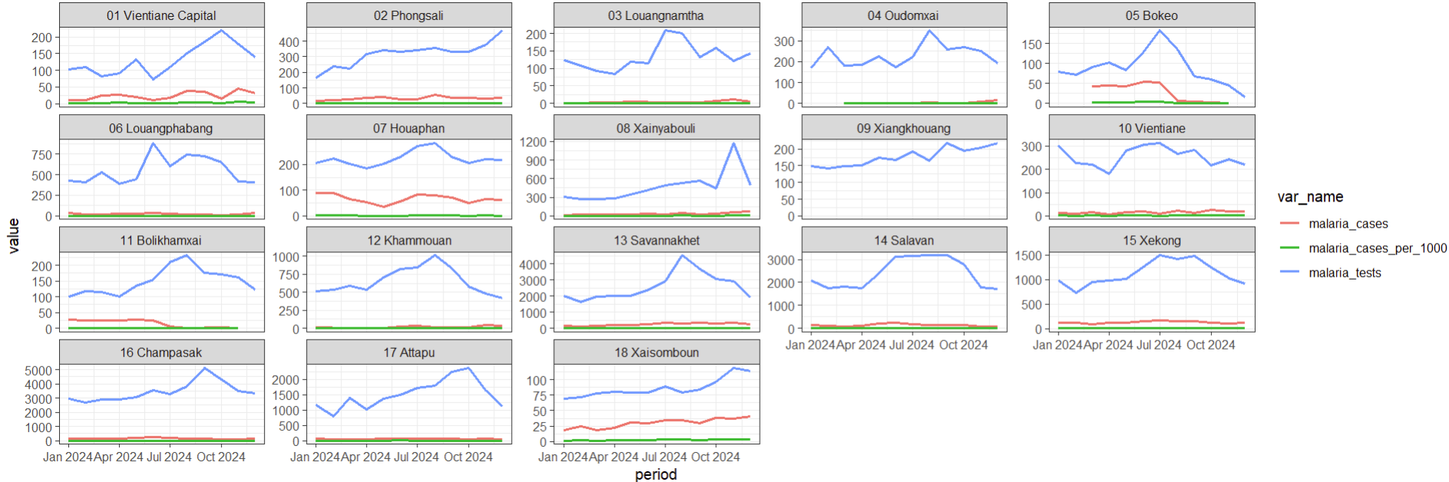
ALWAYS plot your data when cleaning – it’s the easiest way to help spot anomalies/errors
Here we see that province 09 does not have any case or incidence data – lets just remove this from the dataset for now
ggplot(laos_dat_clean2) +
geom_line(aes(x = period, y = value, color = var_name), linewidth = 0.9)+
facet_wrap(vars(organisation_unit), scale = "free_y") +
theme_bw()
Otherwise, there are no glaring errors – we might want to check a few of the big peaks (i.e. in province 08) by going back to DHIS2 and looking at the health facility level data to see if there are any unexpectedly large values

Slide 29
Filter out the province with missing variables
laos_dat_final <- laos_dat_clean2 %>% filter(organisation_unit != "09 Xiangkhouang")
write_csv(laos_dat_final, "data-outputs/data_dhis2_laos_ammnet_cleaned.csv")
Save your output in the data-outputs folder, making note that this is now a cleaned dataset
If you haven’t made it through all the data downloading and cleaning and please download this dataset so you will be ready for part 2: building a shiny dashboard

